Slide 1
Will Dividends Go Up or Down?: Predicting S&P 500 Payouts with Microeconomic and Macroeconomic Data
Ariel Khait | khaitari | ariel.khait@mail.utoronto.ca
Aleksander Dobak | dobakale | alex.dobak@mail.utoronto.ca
Paul Esseyin | esseyinp | p.esseyin@mail.utoronto.ca

Slide 2
Motivation – Why Dividends?
Dividends as the ultimate factor of stock valuation:
Signals company strength and commitment to deliver long-term shareholder value; discounted dividend model.
Sources: Hartford Funds & JP Morgan

Slide 3
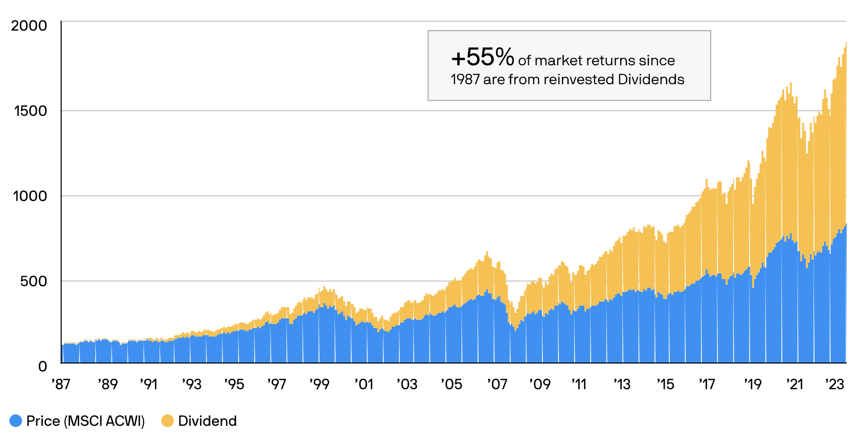
Motivation – Why Dividends?
Dividends as the ultimate factor of stock valuation:
Signals company strength and commitment to deliver long-term shareholder value; discounted dividend model.
Significant Contributor to Returns:
From 1987 to the end of 2023, reinvested dividends accounted for 55% of total market returns. (JP Morgan)
Sources: Hartford Funds & JP Morgan

Slide 4
Motivation – Why Dividends?
Dividends as the ultimate factor of stock valuation:
Signals company strength and commitment to deliver long-term shareholder value; discounted dividend model.
Significant Contributor to Returns:
From 1987 to the end of 2023, reinvested dividends accounted for 55% of total market returns. (JP Morgan)
Extensive Market Impact:
Dividend-paying firms represent over 75% of the total market capitalization of the U.S. stock market. Firms that increase dividends significantly outperform peers in market cap growth over decades, driving wealth creation for investors. (JP Morgan)
Predicting dividend changes requires analysing both firm-specific factors and broader economic indicators.
Sources: Hartford Funds & JP Morgan

Slide 5
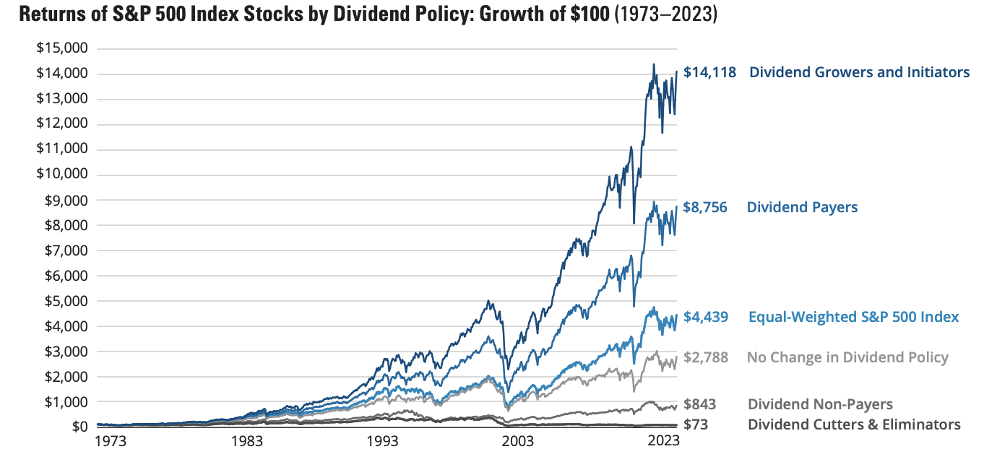
Motivation – Why Dividends?
Dividends as the ultimate factor of stock valuation:
Signals company strength and commitment to deliver long-term shareholder value; discounted dividend model.
Significant Contributor to Returns:
From 1987 to the end of 2023, reinvested dividends accounted for 55% of total market returns. (JP Morgan)
Extensive Market Impact:
Dividend-paying firms represent over 75% of the total market capitalization of the U.S. stock market. Firms that increase dividends significantly outperform peers in market cap growth over decades, driving wealth creation for investors. (JP Morgan)
Predicting dividend changes requires analysing both firm-specific factors and broader economic indicators.
Sources: Hartford Funds & JP Morgan

Slide 6
Main Research Questions and Sub-Questions
Research Question | Using previously available data on firm-specific and macroeconomic factors, can we predict an increase in a firm's total dividends over the next calendar year?

Slide 7
Main Research Questions and Sub-Questions
Research Question | Using previously available data on firm-specific and macroeconomic factors, can we predict an increase in a firm's total dividends over the next calendar year?
Sub Questions | Are microeconomic or macroeconomic features more powerful at predicting the outcome? Which specific features are most effective at predicting a dividend increase? Are there any predictors which are surprisingly relevant/irrelevant? Will previous issuance of dividends impact future dividend increase?

Slide 8
Literature Review
Paper Citation | Dingli, Alexiei and Karl Sant Fournier. ”Financial Time Series Forecasting – A Machine Learning Approach.”
Summary | Uses ML classification and regression to estimate next period stock direction and price change using a 2003-2016 data set of multiple world indices.
Results | 81% accuracy for predicting future trend direction
Similarities with our paper | Uses some similar algorithms: K-Nearest Neighbour (KNN), Random Forest, decision trees, neural networks and Naïve Bayes.
Differences with our paper; contribution. | Focuses on movements in stock price as opposed to movements in dividends. It did not use financial statement information; apart from exchange rates there are no macro predictors. Different data set time frame (2003-2016) and different indices.

Slide 9
Literature Review
Paper Citation | Dingli, Alexiei and Karl Sant Fournier. ”Financial Time Series Forecasting – A Machine Learning Approach.” | Moreira, Ana Catarina Fernandes. ”Prediction of Dividend Yields.”
Summary | Uses ML classification and regression to estimate next period stock direction and price change using a 2003-2016 data set of multiple world indices. | Predicts dividend yield of Australian companies 6 months in advance, using the dividend forecasts of banks and stock market data through ML.
Results | 81% accuracy for predicting future trend direction | Outperforms traditional bank predictions (MAPE for UBS: 118.89%), while ML models achieved lower errors.
Similarities with our paper | Uses some similar algorithms: K-Nearest Neighbour (KNN), Random Forest, decision trees, neural networks and Naïve Bayes. | Predicts dividend related information of publicly traded companies. Some similar algorithms: KNN and Random Forest.
Differences with our paper; contribution. | Focuses on movements in stock price as opposed to movements in dividends. It did not use financial statement information; apart from exchange rates there are no macro predictors. Different data set time frame (2003-2016) and different indices. | Focuses on the use of bank forecasts of public companies to boost its own model. Uses stock price data and time series features. It does not use financial statement information nor macro data. Finally, we are looking at different time frames and locations.

Slide 10
Literature Review
Paper Citation | Dingli, Alexiei and Karl Sant Fournier. ”Financial Time Series Forecasting – A Machine Learning Approach.” | Moreira, Ana Catarina Fernandes. ”Prediction of Dividend Yields.” | Kim, Jinhwa, Chaehwan Won, and Jae Kwon Bae. “A knowledge integration model for the prediction of corporate dividends.”
Summary | Uses ML classification and regression to estimate next period stock direction and price change using a 2003-2016 data set of multiple world indices. | Predicts dividend yield of Australian companies 6 months in advance, using the dividend forecasts of banks and stock market data through ML. | Predicts dividends of Korean companies by using a traditional regression model as a baseline and enhances accuracy by applying AI techniques.
Results | 81% accuracy for predicting future trend direction | Outperforms traditional bank predictions (MAPE for UBS: 118.89%), while ML models achieved lower errors. | It best outperforms the standard model for dividend prediction using KI; combines decision rules from CART trees into one cohesive framework.
Similarities with our paper | Uses some similar algorithms: K-Nearest Neighbour (KNN), Random Forest, decision trees, neural networks and Naïve Bayes. | Predicts dividend related information of publicly traded companies. Some similar algorithms: KNN and Random Forest. | Predicts dividend related information of publicly traded companies. Similarity in algorithms: decision trees and Neural Networks.
Differences with our paper; contribution. | Focuses on movements in stock price as opposed to movements in dividends. It did not use financial statement information; apart from exchange rates there are no macro predictors. Different data set time frame (2003-2016) and different indices. | Focuses on the use of bank forecasts of public companies to boost its own model. Uses stock price data and time series features. It does not use financial statement information nor macro data. Finally, we are looking at different time frames and locations. | Does not use financial statement nor macro data. Does not use random forest. Again, we are looking at different time frames and locations.

Slide 11
Contribution
Firm-Specific Fundamentals:
We incorporate financial statement data, whereas the papers rely on market-derived metrics or external predictions.
Classification vs. Regression:
We address a classification problem (will dividends increase?), while the papers focus on time-series regression of continuous outcomes.
Broader Context:
We integrate macroeconomic factors and industry benchmarks, providing a holistic approach that contrasts with the narrower, market-focused methods in the papers.

Slide 12
Contribution
Firm-Specific Fundamentals:
We incorporate financial statement data, whereas the papers rely on market-derived metrics or external predictions.
Classification vs. Regression:
We address a classification problem (will dividends increase?), while the papers focus on time-series regression of continuous outcomes.
Broader Context:
We integrate macroeconomic factors and industry benchmarks, providing a holistic approach that contrasts with the narrower, market-focused methods in the papers.
Market-derived features
Historical stock prices
Past dividends
Dividend-to-price ratio
Moving averages
Momentum indicators
Volatility indicators
Bank dividend forecasts
Seasonality indicators
Time distance to dividend announcement.
Financial and Macro Features
Cost of goods sold
Inventory
Net Income
Revenue
Bond rates
GDP
Population
M2
Hours worked
CPI

Slide 13
Data Description and Descriptive Statistics
Data ranging from 1990-2023 of today's S&P 500 companies from Yahoo Finance and Warton Research Data Services (WRDS)
Macroeconomics variables from FRED, turned into % change due to stationarity
11,196 panel data observations broken down into 15 macro and 11 micro (company specific) variables.
We look at 444 unique S&P500 companies over 32 unique years.
Preformed an ADF test for stationarity on all variables and eliminated non-stationarity.
Notes:
Still have 7 non-stationary data, the year, the 3 interest rates (decided by FED), Unemployment, and Population and industry average div increase per year
Split the data anywhere from 80/20 to 70/30(don’t mention here)

Slide 14
Data Description and Descriptive Statistics
Data ranging from 1990-2023 of today's S&P 500 companies from Yahoo Finance and Warton Research Data Services (WRDS)
Macroeconomics variables from FRED, turned into % change due to stationarity
11,196 panel data observations broken down into 15 macro and 11 micro (company specific) variables.
We look at 444 unique S&P500 companies over 32 unique years.
Preformed an ADF test for stationarity on all variables and eliminated non-stationarity.
Example Data | Year | div (Div Inc.) | Dividends | Revenue (Millions) | … | rGDP | 10_Year_rate
AAPL | 1992 | 1 | 0.25 | 784 |  | 3.52% | 3.34
 | 1993 | 1 | 0.3 | 972 |  | 2.75% | 2.71
 | 1994 | 0 | 0.3 | 982 |  | 4.03% | 3.54
MSFT | 2010 | 0 | 1.0 | 1346 |  | 2.70% | 0.87
 | 2011 | 1 | 3.5 | 1400 |  | 1.56% | 0.53
 | 2012 | 0 | 0 | 1396 |  | 2.29% | -0.01
Notes:
Still have 7 non-stationary data, the year, the 3 interest rates (decided by FED), Unemployment, and Population and industry average div increase per year
Split the data anywhere from 80/20 to 70/30(mention in Method slides)

Slide 15
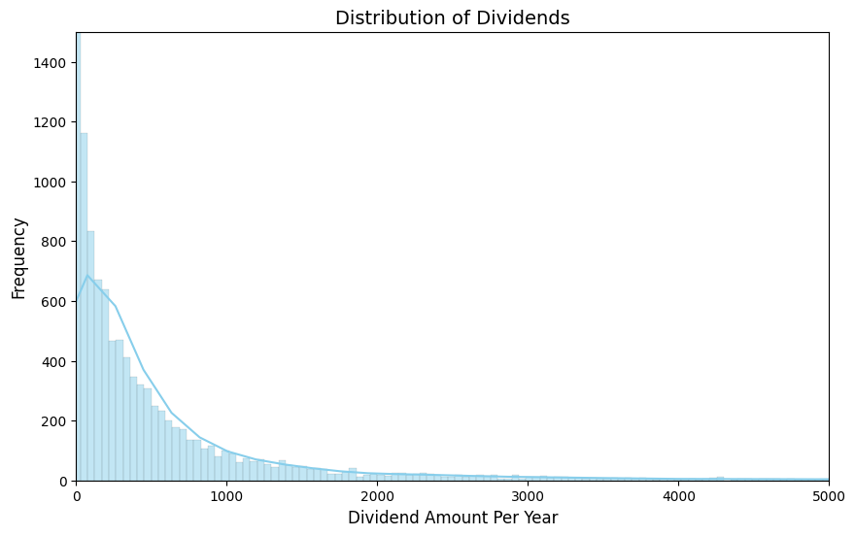
Data Description and Descriptive Statistics
Notes:
Mean of 602.59
Variance of 1,892,155.60
Skewness of 6.511
Kurtosis of 78.312
"Long Tails", like the Microsoft dividends in 2005 (35 million one time div)
False Positive Rate: number of Positives that should be negative as a percent of all negative predictions
Recall: True positive rate or the number of correctly predicted positive results over the total number of positive results

Slide 16
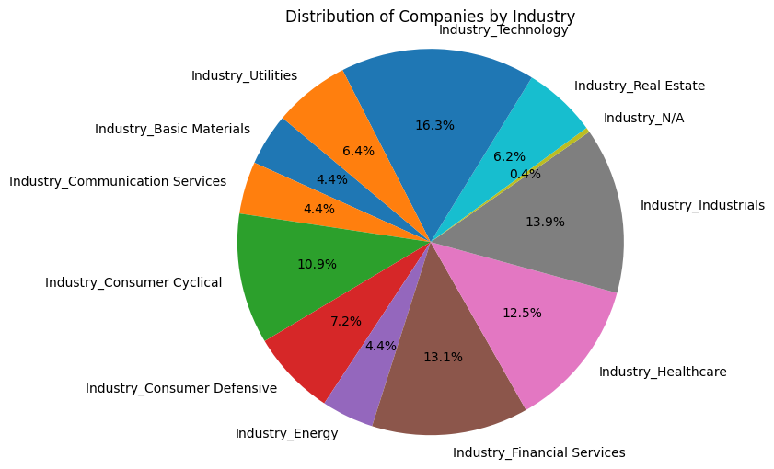
Data Description and Descriptive Statistics
Notes:
Mean of 602.59(million)
The distribution of dividend data is log normal.
Variance of 1,892,155.60
Skewness of 6.511
Kurtosis of 78.312 (Fat tails)
Microsoft 2005 had 35 million one time dividend (example)
Mention Pie chart

Slide 17
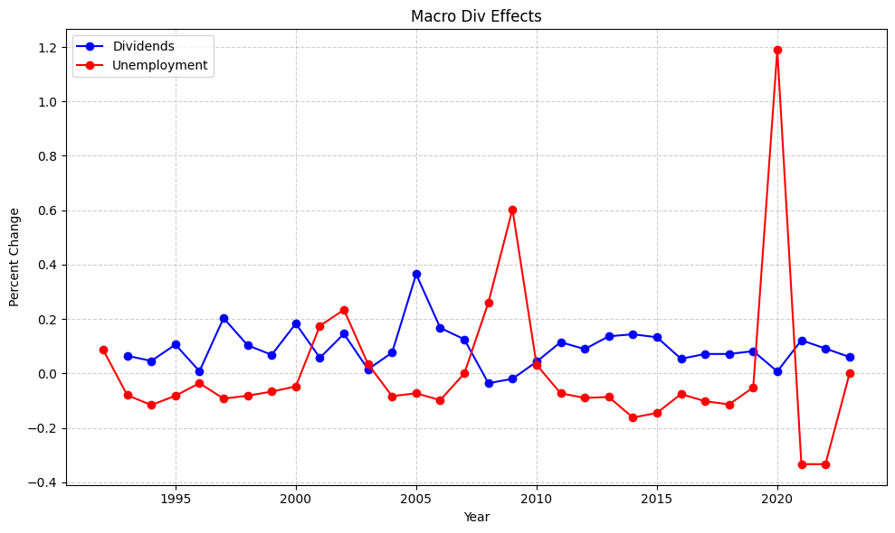
Data Description and Descriptive Statistics
Notes:
- Important to note for the graph, we look at CURRENT companies in the S&P500. This means some of them may not have existed or payed div back in 1992 where we start our analysis.
Excluding MSFT’s big dividend in 2005, we see the pct change decrease from 0.7 to 0.35 but still have a massive spike in 2005.
Inverse relation between percent change in unemployment and percent change in dividends

Slide 18
Methodology
Data Splitting
Standardization
Utilized a Grid Search algorithm to fine tune parameters
Standardized the X variable for certain models
Grid Search:
Models without Macro
Ran models without Macroeconomic variables included
Models with Macro
Ran models with Macroeconomic variables included
Results
Compared the results
We split the data between 80/20 and 70/30 depending on the model
Notes:
Mention the splits here.

Slide 19
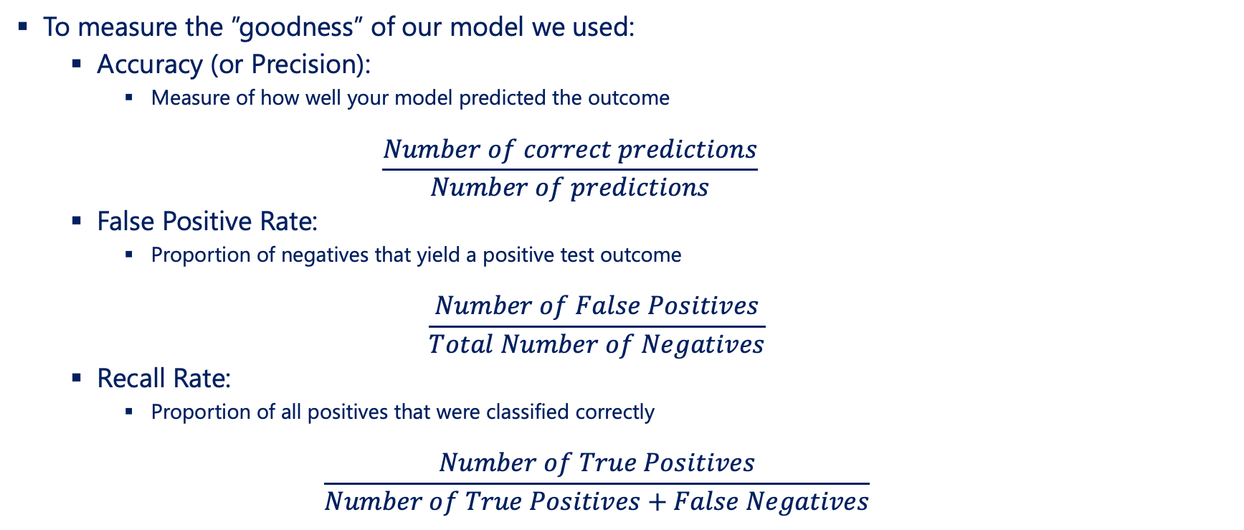
Methodology
To measure the ”goodness” of our model we used:
Accuracy (or Precision):
Measure of how well your model predicted the outcome
$$\frac{Number of correct predictions}{Number of predictions}$$
False Positive Rate:
Proportion of negatives that yield a positive test outcome
$$\frac{Number of False Positives}{Total Number of Negatives}$$
Recall Rate:
Proportion of all positives that were classified correctly
$$\frac{Number of True Positives}{Number of True Positives+False Negatives}$$
Notes:
- Remember to describe False Positive Rate and Recall rate intuitively
False positive rate is the probability of falsly rejecting the null hypothesis, (ie should have been 0 but we classify as 1)
Recall is the number of true postives correctly classified as positive (number of actual 1's classified as 1's)

Slide 20
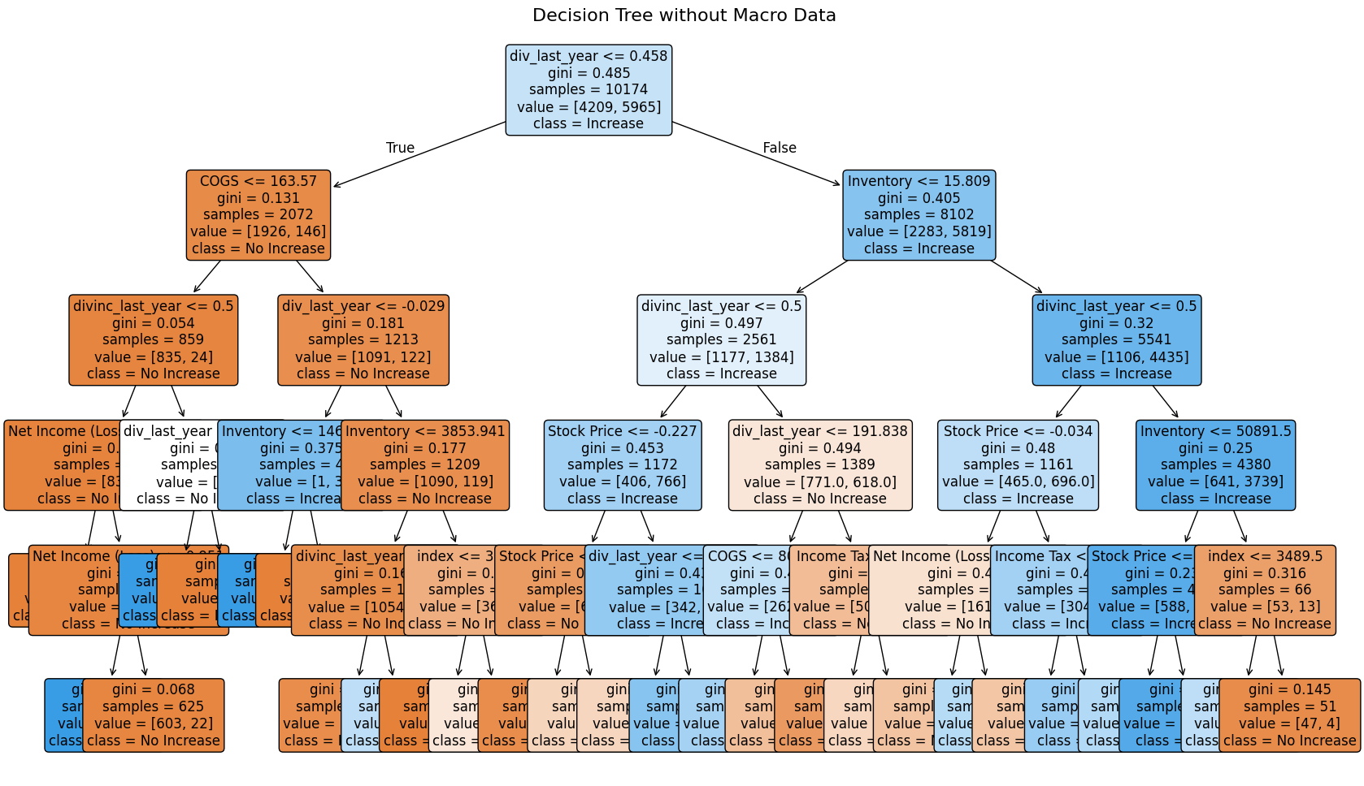
Classification Tree – WITHOUT Macro Data
Notes:
Accuracy: 79.36%
False Positive Rate: 34.97% Recall Rate: 89.9%
Common Nodes:
Dividend Last Year
COGS
Dividend Increase
Net Income
Inventory

Slide 21
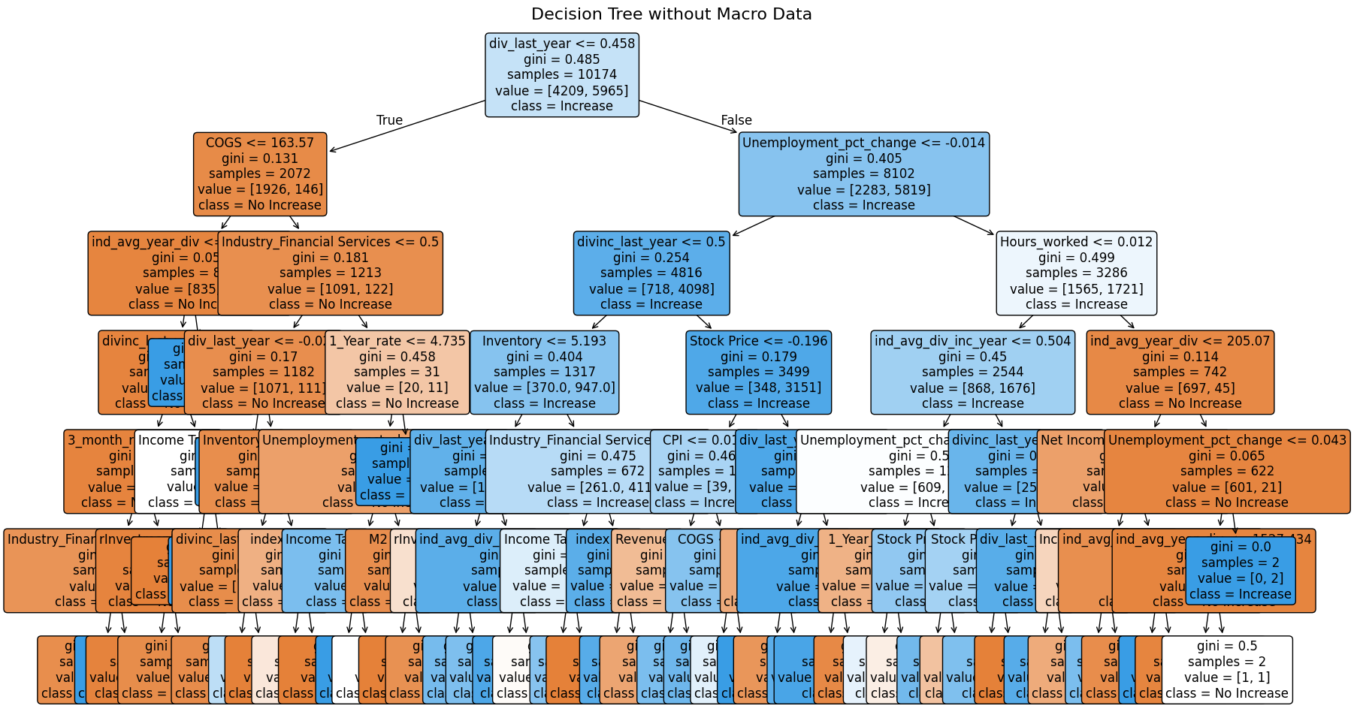
Classification Tree – WITH Macro Data
Notes:
Notice how high up unemployment, hours worked, and the 1 year rate are
Accuracy: 84.35%
False Positive Rate: 23.1% Recall Rate: 89.9%

Slide 22
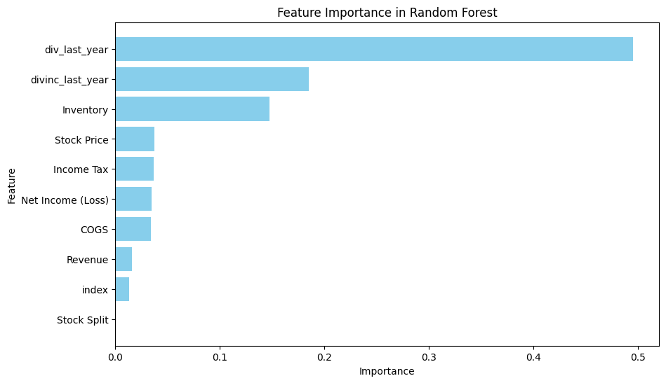
Random Forest – WITHOUT Macro
Notes:
Random Forest Model
Accuracy: 78.56%
False Positive Rate: 42.87%
Recall Rate: 94.36%

Slide 23
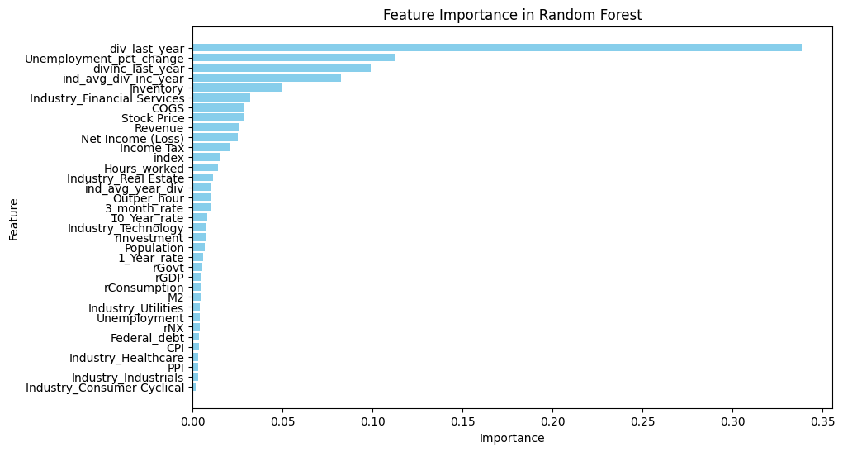
Random Forest – WITH Macro
Notes:
Random Forest Model
Accuracy: 84.35%
False Positive Rate: 14.02%
Recall Rate: 86.29%

Slide 24
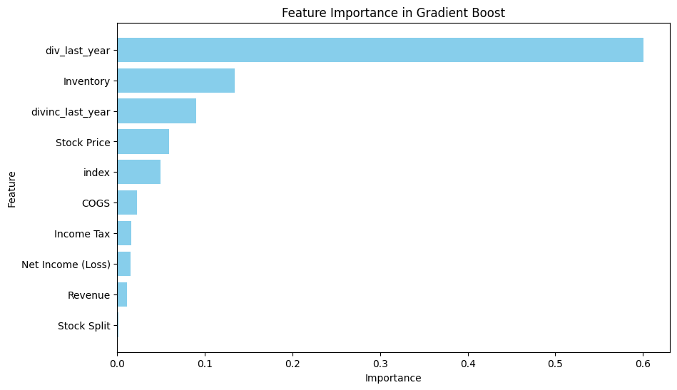
Boosting Tree – WITHOUT Macro
Notes:
- 81.22 Percent Accuracy on 5 runs
Recall rate of 91.28%
False Positive Rate of 32.9%

Slide 25
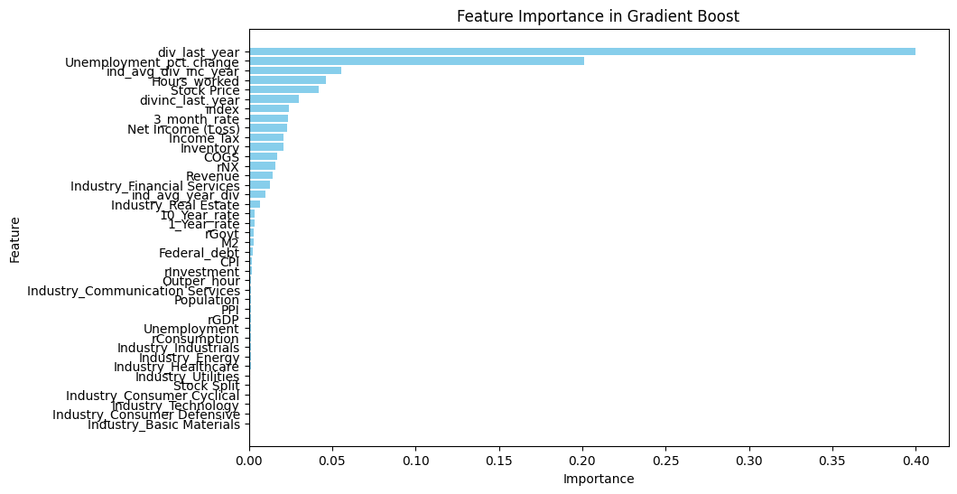
Boosting Tree – WITH Macro
Notes:
We ran it 5 times and got an average score of 86.85% Accuracy
Recall Rate of 92.97
False Positive Rate of 21.26

Slide 26
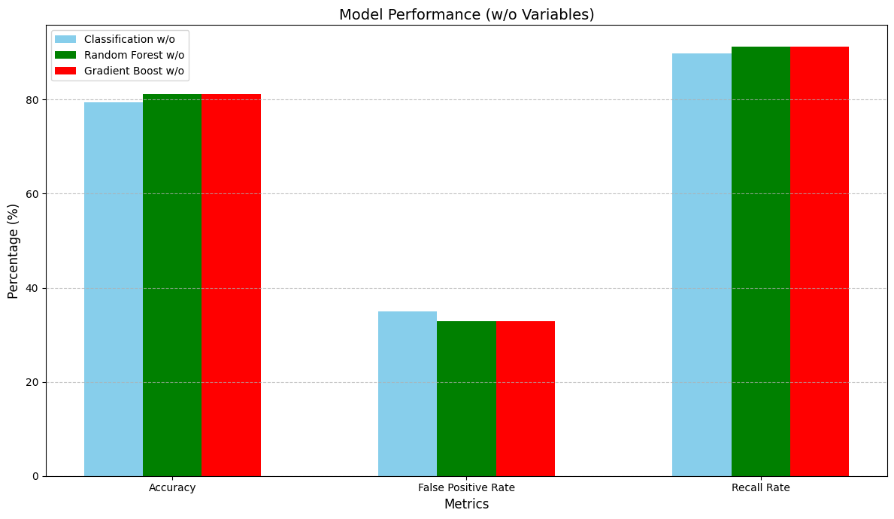
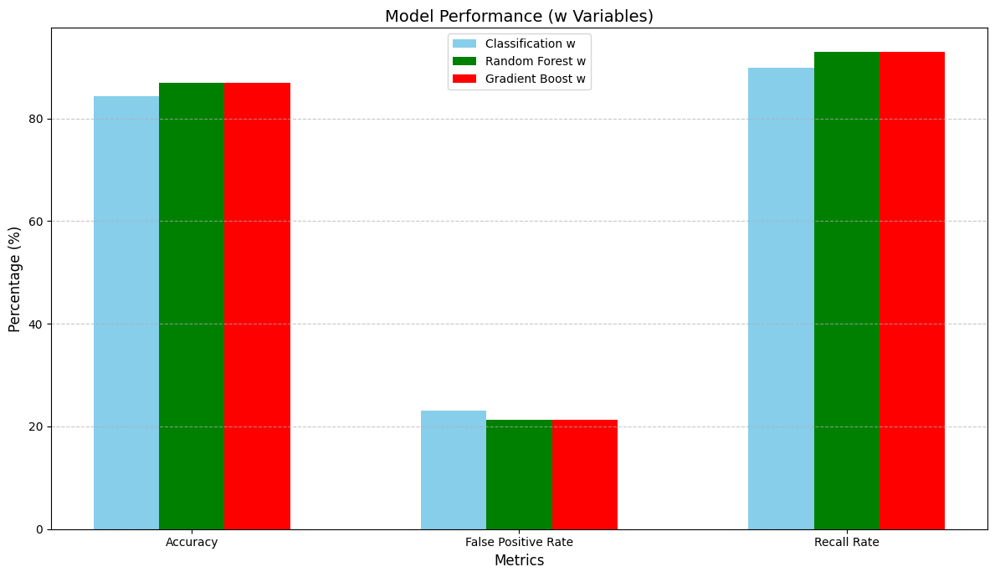
Results
Notes:
- Ran other models as well but all had accuracy under 70%
- 5.5 percent increase in Gradient Boost with Macro
6 Percent increase in Random Forest
5 Percent higher in the Classification Tree
We see a significant decrease in the false positive rate (almost 15 percent per model)
False Positive Rate: number of Positives that should be negative as a percent of all negative predictions
Recall: True positive rate or the number of correctly predicted positive results over the total number of positive results

Slide 27
Answers to our research questions
Question | Answer
Using previously available data on firm-specific and industry/macroeconomic factors, can we predict an increase in a firm's total dividends over the next calendar year? | Yes, we get an accuracy rate of 84.35% with our Random Forest model and a recall rate of 86.29%; effectively leverages firm-specific and industry/macro factors to predict increases in a firm's total dividends.
Are microeconomic or macroeconomic features more powerful at predicting the outcome? | Market features and firm specific data are more powerful predictors. However, industry averages and population have high predictive capacity on the classification and boosting trees.
Which specific features are most effective at predicting a dividend increase? Are there any predictors which are surprisingly relevant/irrelevant? | Population was the most relevant macro feature. Surprising – there are more obvious macro variable such as GDP. Dividend increase last year was the most powerful. Demonstrates the power of momentum.
Will previous issuance of dividends impact future dividend increase? | Yes, in fact this was our most powerful feature. The strong predictive power of past dividend increases aligns with EMH; it reflects market-recognized patterns of dividend "stickiness"; note, it’s used probabilistically and not as a guaranteed outcome.
Notes:
-

Slide 28
Answers to our research questions
Question | Answer
Using previously available data on firm-specific and industry/macroeconomic factors, can we predict an increase in a firm's total dividends over the next calendar year? | Yes, we get an accuracy rate of 84.35% with our Random Forest model and a recall rate of 86.29%; effectively leverages firm-specific and industry/macro factors to predict increases in a firm's total dividends.
Are microeconomic or macroeconomic features more powerful at predicting the outcome? | Market features and firm specific data are more powerful predictors. However, industry averages and population have high predictive capacity on the classification and boosting trees.
Which specific features are most effective at predicting a dividend increase? Are there any predictors which are surprisingly relevant/irrelevant? | Population was the most relevant macro feature. Surprising – there are more obvious macro variable such as GDP. Dividend increase last year was the most powerful. Demonstrates the power of momentum.
Will previous issuance of dividends impact future dividend increase? | Yes, in fact this was our most powerful feature. The strong predictive power of past dividend increases aligns with EMH; it reflects market-recognized patterns of dividend "stickiness"; note, it’s used probabilistically and not as a guaranteed outcome.
Fundamentally: By identifying firms likely to increase dividends, our model can guide investors toward firms that historically outperform, amplifying returns through both share price growth and reinvested payouts.

Slide 29
Bibliography
Bloomberg LP. "Data accessed via Bloomberg Terminal." Accessed October-November 2024.
Dingli, Alexiei and Karl Sant Fournier. ”Financial Time Series Forecasting – A Machine Learning Approach.” Machine Learning and Applications: An International Journal 7, no. 5 (October 2017): 11-27.
Federal Reserve Bank of St. Louis. "Federal Reserve Economic Data (FRED)." Accessed 26th October 2026. https://fred.stlouisfed.org.
Hartford Funds. "The Power of Dividends: Past, Present, and Future." Whitepaper, Hartford Funds, 2021. Accessed November 26, 2024. https://www.hartfordfunds.com/dam/en/docs/pub/whitepapers/WP106.pdf.
J.P. Morgan Asset Management. "The Era of Accelerated Dividend Growth Is Upon Us." Accessed November 26, 2024. https://am.jpmorgan.com/gb/en/asset-management/adv/insights/portfolio-insights/pm-perspectives/equities/the-era-of-accelerated-dividend-growth-is-upon-us/.
Kim, Jinhwa, Chaehwan Won, and Jae Kwon Bae. “A knowledge integration model for the prediction of corporate dividends.” Expert Systems with Applications 37, no. 2. (March 2010): 1344-1350.
Moreira, Ana Catarina Fernandes. ”Prediction of Dividend Yields.” Master's thesis, Universidade do Porto, 2022.
Williams, John Burr. The Theory of Investment Value. Cambridge, MA: Harvard University Press, 1938.

